Slide 1
Pragmatic Approaches to Cloud
Harippriya Sivapatham
IDC Cloud Fest 2018

Slide 2
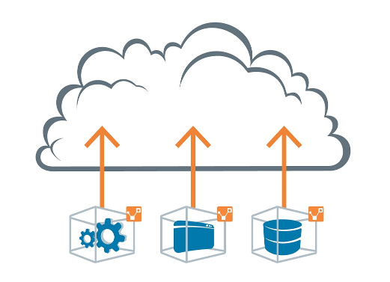

Agenda
1
Migration to Public Cloud
2
SaaS Hosting Solutions

Slide 3
NIST: Cloud Application Characteristics
Elasticity
Resource Pooling
(Multi-tenancy, etc.)
Network Access
Self Service
Metering
Stateless
No Local storage
Infrastructure Independent
Balance
Cost Savings
Easy to Manage

Slide 4

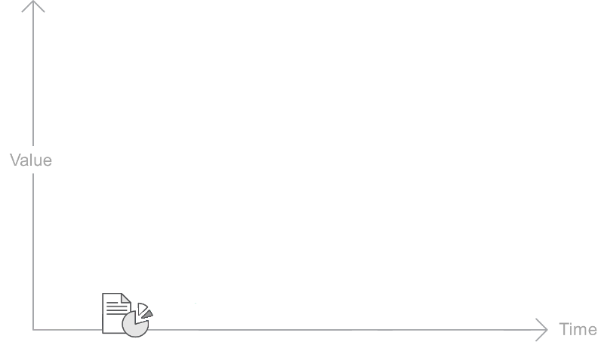


Paths to Cloud / SaaS
RE-INVENT AS
CLOUD-CENTRIC
PHASED
ENHANCEMENTS
MIGRATE
HOSTED SaaS
CLOUD NATIVE
ENTERPRISE APPLICATION

Slide 5






6 R’s Migration Strategy from Gartner/AWS
“lift-and-shift” to meet business needs quickly.
Known as “lift-and-shift”
Pros:
Deploy as-is on cloud VM
Quickly meet business needs
Cons:
Does not provide any cloud advantages
“lift-tinker-and-shift” to leverage cloud and
meet business needs quickly.
Known as “lift-tinker-and-shift”
Pros:
No changes to core architecture
Enhance to leverage cloud provider functionality
Sweet spot for enterprise apps.
Re-architect. Expensive but is future direction.

Slide 6
Migration Steps

Slide 7
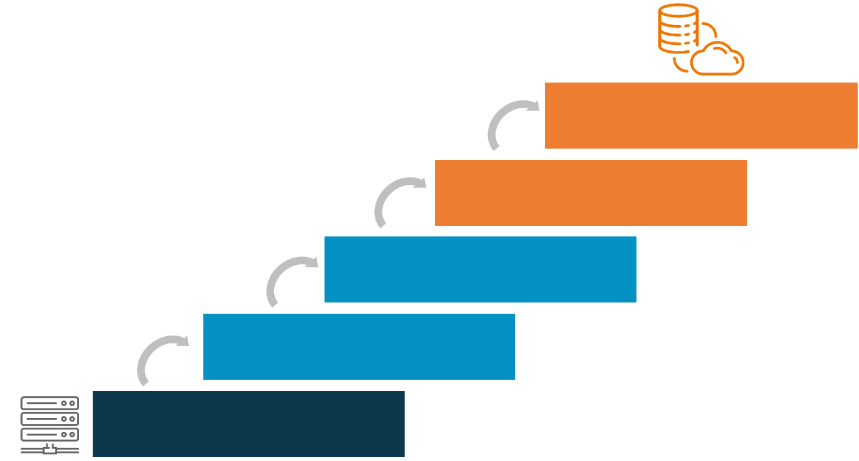
Migration Steps
CERTIFY
OPTIMIZE
DEPLOY
SECURE
STRATEGIZE

Slide 8
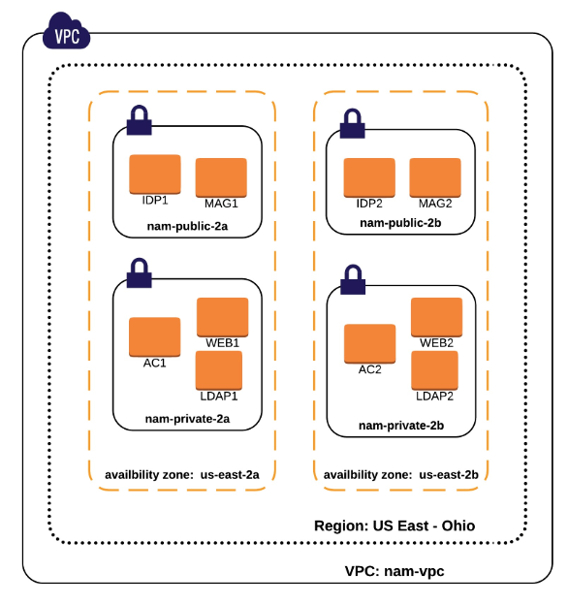
Strategize
Secure
Deploy
Certify
Leverage
Access Manager on AWS
Create strategy for the components.
Hybrid Integration Plans.
Create Deployment Architecture
Come up with a phased approach!
POC
Federation
Access Manager on Enterprise
Notes:
Not suitable – performance/latency sensitive, voluminous transactions, legacy platform, non-virtualized, special drivers or hardware, specific type of server

Slide 9
Strategize
Secure
Deploy
Certify
Leverage
Shared Responsibility Model
Application Level Security
Securing data at rest, data in transit
Securing multi-tenant environment
Securing connections
Infrastructure Based Security
Use cloud provider functionality – VPC, VPN, AWS Direct Connect
Notes:
Not suitable – performance/latency sensitive, voluminous transactions, legacy platform, non-virtualized, special drivers or hardware, specific type of server

Slide 10
Strategize
Secure
Deploy
Certify
Leverage
Deploy and verify on Cloud.
Assess performance and recommend deployment strategy.
Notes:
Not suitable – performance/latency sensitive, voluminous transactions, legacy platform, non-virtualized, special drivers or hardware, specific type of server

Slide 11
Strategize
Secure
Deploy
Certify
Leverage
Disaster Recovery
Automatic Scaling
Elastic Load Balancer
Cloud Formation Templates for easy deployment
Backup and Archiving - S3 and Storage Gateway
Monitoring and Management
Notes:
Not suitable – performance/latency sensitive, voluminous transactions, legacy platform, non-virtualized, special drivers or hardware, specific type of server

Slide 12
Strategize
Secure
Deploy
Certify
Leverage
Provides better visibility and creates trust.
AWS
Undergo AWS Well Architected Review
Managed AMIs can be published through Micro Focus account.
Listing on AWS marketplace is not necessary / desirable.
Azure – same process as AWS but simplified
Notes:
Not suitable – performance/latency sensitive, voluminous transactions, legacy platform, non-virtualized, special drivers or hardware, specific type of server

Slide 13
SaaS Strategy

Slide 14
Hosted SaaS Options
Micro Focus takes care of:
Installing, monitoring and managing our products
Managing hardware
Scale the product to meet the SLAs.
Seamless SSO across products
Hosting Options: Control Tower or Services Director
SaaS enabling our product
Integrate using their APIs
On-prem solutions can also be provided as SaaS offering.

Slide 15
Control Tower
Services Director
Hosted and maintained by Micro Focus on our own data centers and AWS.
UI to manage service, renew licenses, etc.
User management with corporate sync and auto provisioning.
Software licensing using Auto Pass
View service health, SLA on availability, etc.
Federation across hosted SaaS services.
OAuth for APIs exposed by services.
Inventory management
Used in production by many HPE products.
Hosted and maintained by infrastructure provider Logicalis on Azure
Minimal UI to request service and manage.
User creation with 3 pre-defined roles.
Paper licenses. No license checks.
No SLA checks.

Slide 16
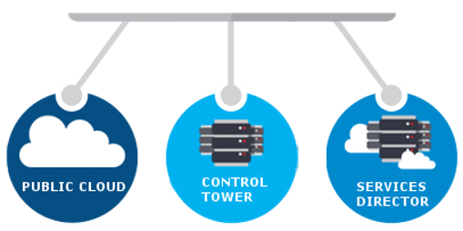

Summary
Choose the option right for you
ENTERPRISE
Cloud / SaaS Options in Micro Focus
Devise a phased approach for migration.
Long term: think about making your application stateless, multi-threaded, etc.

Slide 17
Thank You.

